Slide 1

Beyond Care : Post - Care Recovery Hospital Management System
Group - 30
Samiksha Gupta
Prachi Pradhan
Dale Alphonso

Slide 2
Problem Statement
Gap in Recovery Support
Increased Readmission Rates
Current systems often lack robust mechanisms to facilitate smooth transitions from hospital to home, leading to challenges in adherence and patient engagement.
Poor post-care management contributes to high readmission rates, putting a strain on healthcare systems and impacting patient well-being.
Lack of Cross-Institutional Integration
High Cost of Readmissions
Existing solutions often operate in silos, lacking seamless integration between healthcare providers, pharmacies, insurance companies, and patient support systems
Readmissions due to poor post-care management significantly increase healthcare costs for providers, insurance companies, and patients.

Slide 3
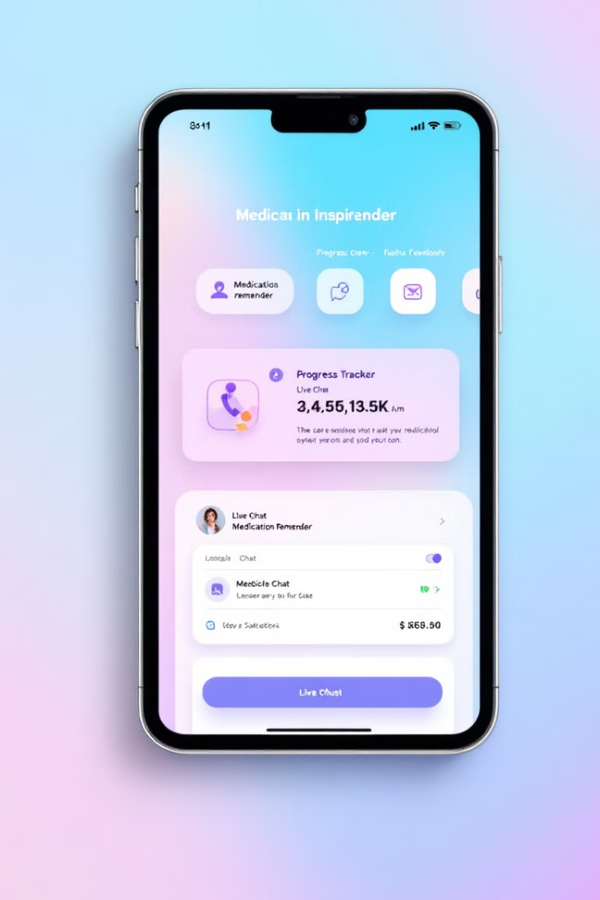




Key Features of BeyondCare
Nurse Management
Patient Portal
Manage patients.
Schedule and manage appointments. Access doctor and hospital details.
Accept/reschedule appointments and handle feedback.
Order and track medications.
Submit insurance claims.
Alerts & Notifications
Data Analytics
Send quick reminders for appointments and coordination.
Admins can view health reports and recovery trends.
Email lab reports status directly to patients.
Analyze patient outcomes.

Slide 4
Enterprises and Organizations
Hospital
Pharmacy
Clinical Support
Insurance
Doctor Organisation
Pharmacy Organisation
Lab Assistant
InsuranceOrganisation
Nurse
Patient
Accountant
PatientSupportGroup

Slide 5
Workflow
Sysadmin
Manage Hospital
Manage Pharmacy Account
Hospital Admin
Manage Insurance Provider Account
Manage Staff
Dashboard
Manage Lab Assitant
Pharmacy
Check Medicine Orders from Patients
Creates Medicines In Inventory
Nurse
Manage Patients
Manage Appoints and Patient Request

Slide 6
Patient
Manage Appointment , View Doctor information , Manage medicine order , View hospital information , Insurance claim form
Doctor
View Patient Request
Lab Assistant
Virtual Consultation
View Lab Request Form
Start Lab Test
Accountant
View Billing Information
Insurance
View Claims and Generate Reports
Approve or Decline claims

Slide 7
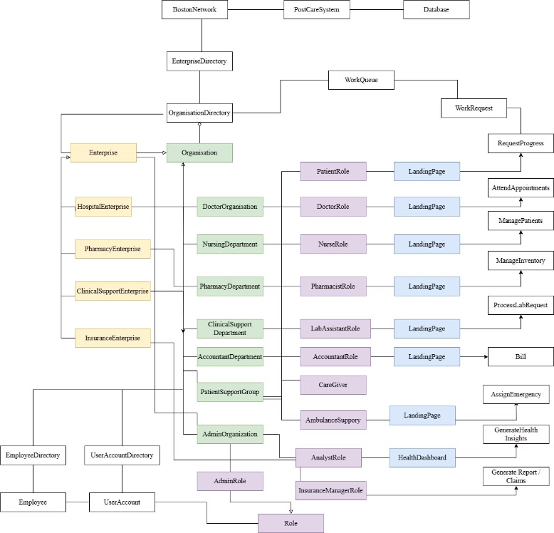
UML Diagram

Slide 8
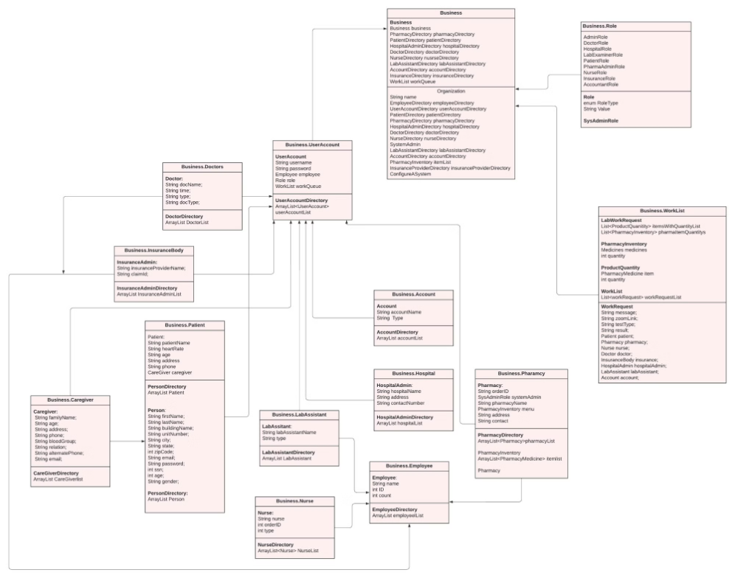
Class Diagram

Slide 9
Thank You

